Slide 1
Leveraging BlackBerry Services: BBM and Scoreloop
JAM 347
Nick Kalkounis – Product Manager
Sonja Ängeslevä – Product Manager
Mark Sohm – Developer Relations
February 5-6, 2013

Slide 2
For More Information…
Come to the Lab! JAM 347 - BBM Integration in the NDK and WebWorks (Wed @ 3:30pm)
http://developer.blackberry.com/bbm
http://www.scoreloop.com/download/
Let us know about the cool things you’ve done!
nkalkounis@rim.com - @nickkalkounis
skangas@rim.com - @souplala
msohm@rim.com MSohm in the BlackBerry Developer Forums

Slide 3


Agenda
Scoreloop
BlackBerry Messenger
Social Platform

Slide 4
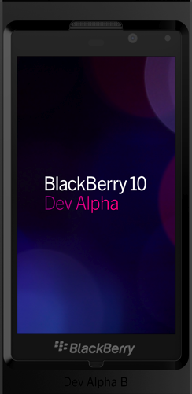
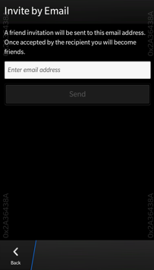
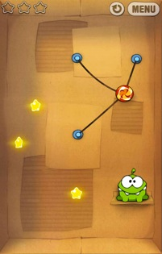
In a nutshell
Global Leaderboards
Achievements
Player Challenges
Social Network Integration
Online Gaming Profile
In-Game Currencies
Downloadable Content
Virtual Goods

Slide 5
Connect games and the people who play them
Cross platform: BlackBerry 10, Android, iOS, WP, Marmalade
Active Games: 2400
Total users: 250M
Daily Active Users: 3.5M
Monthly Active Users: 38M
Over 10b high scores

Slide 6


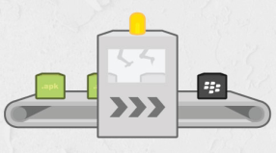
Publish now on BlackBerry 10
BlackBerry Native SDK for BB10
Marmalade SDK
Blackberry Runtime for Android Apps

Slide 7
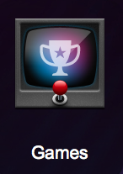
The Games App
The Games App is a preloaded application on the home screen of BB10. It is the best position to promote your games!
As a central gaming experience on BlackBerry it enhances social and viral discovery of all social Scoreloop enabled games.

Slide 8
The Games App feature overview
Connect with other BB10 gamers
Find friends on BBM
Discover your friends’ games
See friends' gaming activities
Compare gaming skills with friends

Slide 9
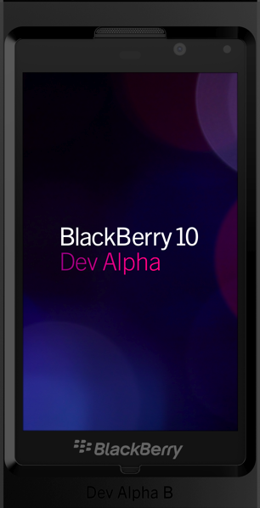
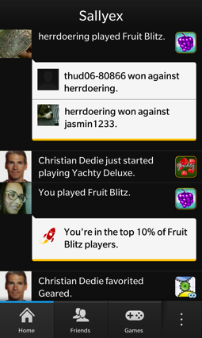
Features: See & Compare
See friends’ gaming activities.
Compare gaming skills with friends.

Slide 10


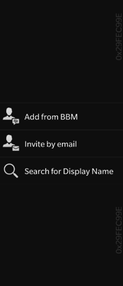
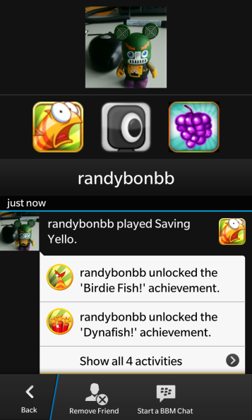
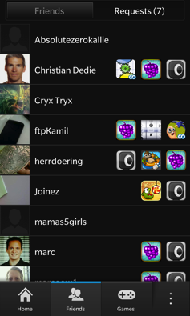
Features: Find & connect
Find friends on BBM or email
Other options available to find friends.
Choose from friends already playing and invite others.
Chat with your gaming friends.

Slide 11

Features: Connect
Connect with other BB10 gamers.
Invite by email and add your BBM contacts.
Receive achievement and challenge news updates from friends and stay engaged.

Slide 12

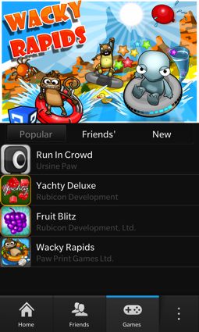
Features: Discover
Discover your friends’ games.
Find the most popular games, your friends’ favorites and all new social games.
Download directly from BlackBerry World.

Slide 13
Scoreloop SDK
Scoreloop SDK = set of key social features for your game
Integrate with the Games app for ultimate visibility on BB10
Make your game better with social features

Slide 14

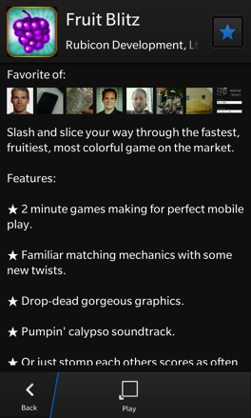
Scoreloop SDK feature overview
User profile
Leaderboard
Achievements
Challenges
Gaming data storage
Be creative!
Default UI: leaderboards, challenges, favorite a game and achievements

Slide 15

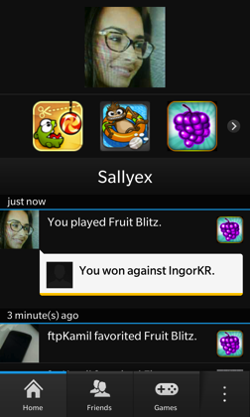
Features: User profile
Build a gaming identity that persists across games.

Slide 16

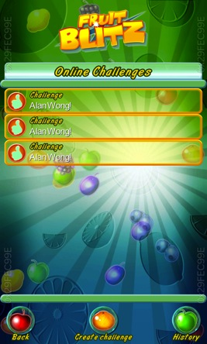
Features: Challenge
Challenge friends directly from within games.

Slide 17

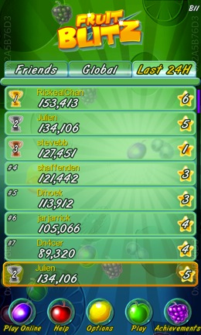
Features: Leaderboard
See global Leaderboards & your friends’ ranking.
Compare gaming scores and achievements and compete with BBM friends to see who is the best gamer.

Slide 18
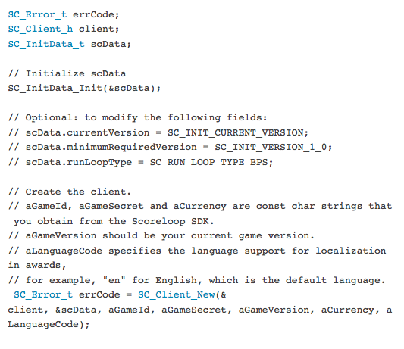
Improve discoverability - games
Notes:
http://developer.blackberry.com/native/documentation/bb10/com.qnx.doc.scoreloop.lib_ref/topic/coresocial-quick-guide.html

Slide 19
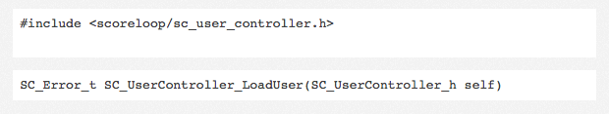
Improve discoverability – games

Slide 20
More resources
Our Support team is there to help you! http://support.scoreloop.com/
Scoreloop SDK documentation http://www.scoreloop.com/download/
BB10 NDK http://developer.blackberry.com/native/download
BlackBerry Developer Wiki http://supportforums.blackberry.com

Slide 21
BBM Social Platform
BlackBerry Messenger
Social Platform

Slide 22


BBM Agenda
$$$
developer.blackberry.com/bbm
What.
Why.
How.

Slide 23
BBM: A Vibrant Social Network
60 Million+ Monthly Active Users
2 Million+ New users every month
70% of BBM users use BBM daily
> 150B messages sent/month
+2% of Apps are BBM Connected
…But they make up 20% of App World Downloads!

Slide 24






The BBM Social Platform
Discoverability
App Stickiness
Engagement
Monetization

Slide 25
BBM Social Platform APIs
Available Now!
BBM Contact List & Invitations
User Profile Updates
Application Box Updates in User Profile
Invoke BBM through Invocation APIs

Slide 26
BBM Contact List and Invitations
Ability to Invite your BBM contacts to download an application (Integrated with BlackBerry World)
Obtain a list of BBM contacts that have the application installed and registered
Listen for changes to profiles of these contacts
Status change to -> “Wants to play SlingShot 5000 with someone”
Local app could prompt the user to start a multiplayer game
Best Practice: Make it easy for users to find the invite button…but try to make it feel integrated into the application

Slide 27
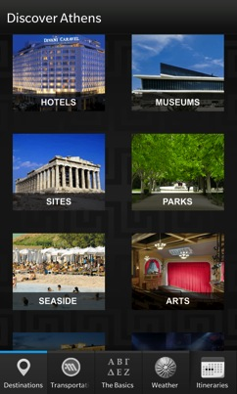
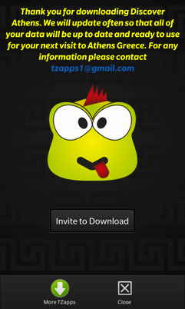
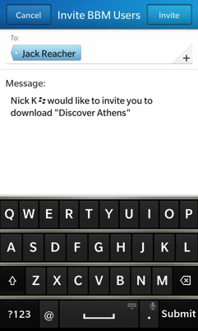

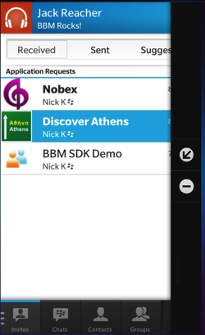
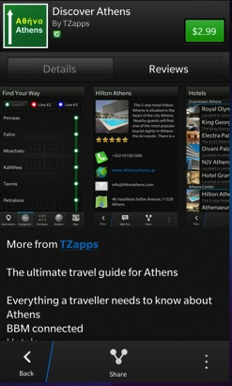

BBM Contact List and Invitations

Slide 28
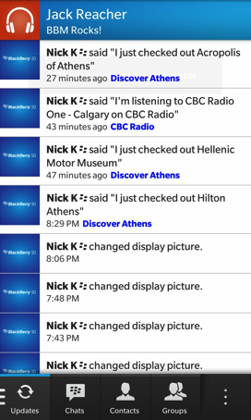
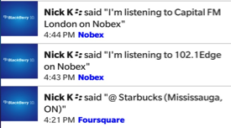
User Profile Updates
Ability to update the user’s BBM Profile information
Personal Status Message
Avatar
Availability
App that makes the change shows up in the context of the update in the BBM Updates tab
Best Practice: Make the updates relevant for example: “Checked into Starbucks at location X” instead of “I’m using Foursquare”

Slide 29

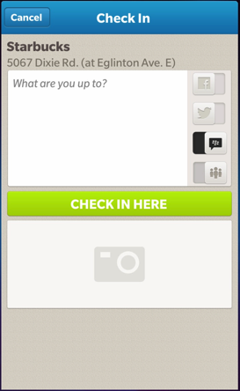
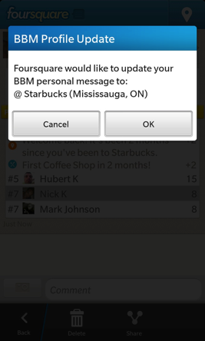
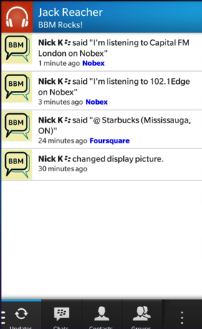
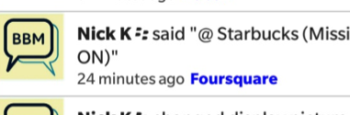
User Profile Updates

Slide 30
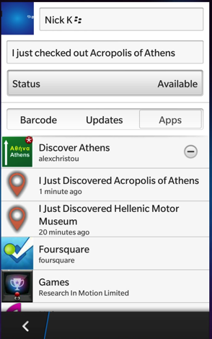
Application Box Updates in User Profile
BBM Connected apps are listed in a users BBM Profile
Clicking items launch the apps (or BlackBerry World)
Add items within your app’s Profile Box
Achievements, high scores, current track, important news
Best Practice: Take advantage of Profile Box Items…coming soon is ability to launch your app and pass it context!

Slide 31
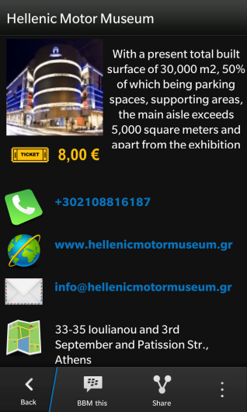
Application Box Updates in User Profile
If BBM friend doesn’t have app
Coming Soon..
If BBM friend has
App installed

Slide 32
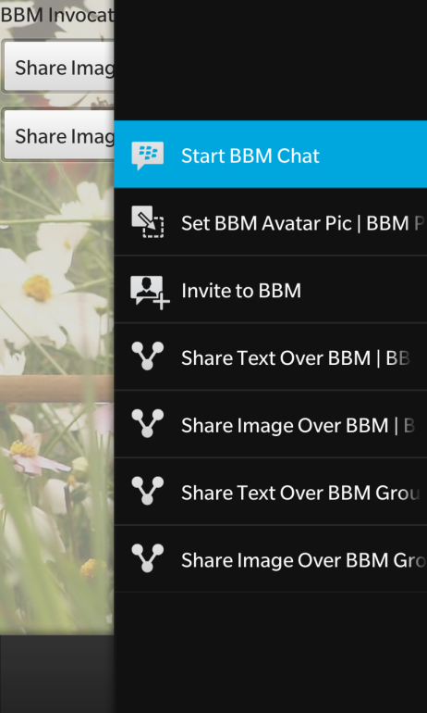
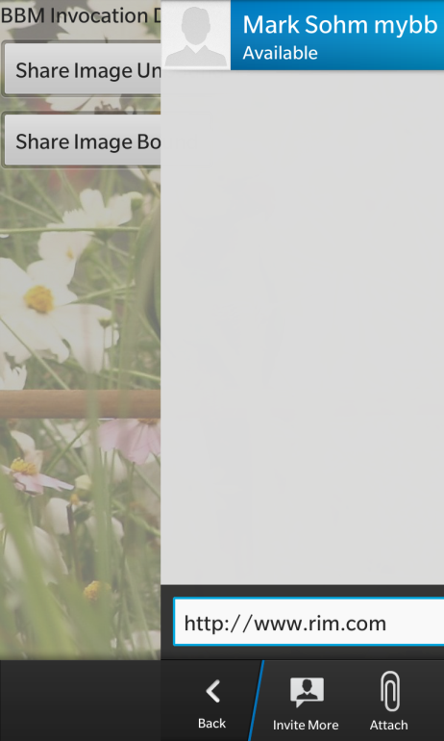
Invoking BBM
Use the Invocation Framework to Invoke the BBM Client to…
Start chat with specific contact(s)
Start chat, user chooses contact(s)
Set BBM Avatar Image
Invite Contact to BBM
Share Text with contact(s)
Starts chat with pre-populated message
Share Image with contact(s)
Share Custom Data…

Slide 33
Start BBM Chat
InvokeActionItem {
title: "Start BBM Chat“
query {
invokeActionId: "bb.action.BBMCHAT"
uri: "pin:2100000A"
}
}
Application Specifies Contact

Slide 34
Share Text Over BBM
InvokeActionItem {
title: "Share Text Over BBM"
query {
mimeType: "text/plain"
invokeTargetId: "sys.bbm.sharehandler"
invokeActionId: "bb.action.SHARE“
data: "This is some text to share."
}
onTriggered: {
data = "http://www.rim.com"
}
}
User Selects Contact

Slide 35
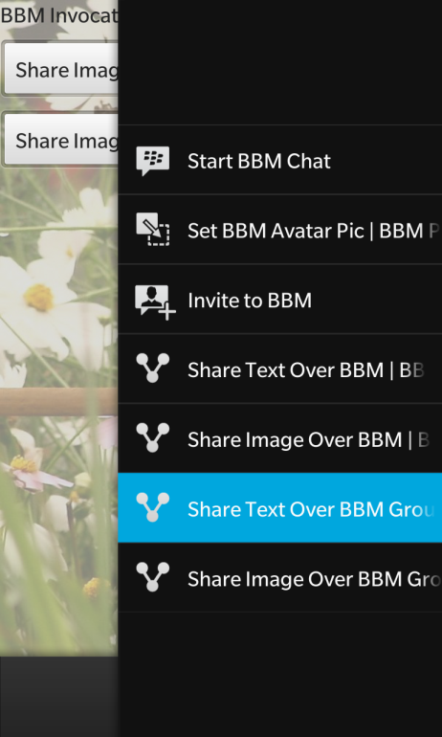
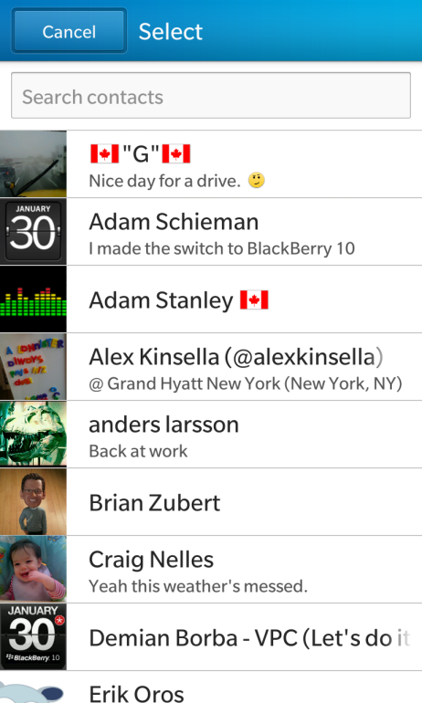
Share Text Over BBM
User Selects Contact Text/Data Can Be Empty

Slide 36
Sharing Custom Data over BBM
Use the invocation framework and BBM to…
Start a chat session and send the file with custom data
Open the file when touched in BBM.
Let’s see that in action. DEMO TIME!

Slide 37
Sharing Custom Data over BBM
How was that done?
Let’s see the code for:
Sending Data
Receiving Data
Sending Data
Create File to Send
Invoke BBM and send file

Slide 38
Sending Data
QString path =
QDir::current().absoluteFilePath("data/bucketItemToShare.buk");
m_pInvocation = Invocation::create(
InvokeQuery::create().parent(this).uri(
QUrl::fromLocalFile(path)).invokeTargetId("sys.bbm.sharehandler"));
QObject::connect(m_pInvocation, SIGNAL(armed()), this, SLOT(onArmed()));

Slide 39
Sending Data
//Respond to the signal
void BucketModel::onArmed()
{
m_pInvocation->trigger("bb.action.SHARE");
}

Slide 40
Sharing Custom Data over BBM
Receive the data…
Add the target to the bar-descriptor.xml
Connect the invocation signal to a slot in our application
Take action when the signal is received

Slide 41
Receiving Data
<invoke-target id="com.samples.rim.bucketlist_share">
<invoke-target-type>application</invoke-target-type>
<invoke-target-name>bucketlist_share</invoke-target-name>
<icon>
<image>icon.png</image>
</icon>
<filter>
<action>bb.action.VIEW</action>
<action>bb.action.OPEN</action>
<mime-type>*</mime-type>
<property var="exts" value="buk"/>
<property var="uris" value="file://"/>
</filter>
</invoke-target>

Slide 42
Receiving Data
//Connect the Signal to our Slot
QObject::connect(m_invokeManager,
SIGNAL(invoked(const bb::system::InvokeRequest&)),
this,
SLOT(handleInvoke(const bb::system::InvokeRequest&)));

Slide 43
Receiving Data
void BucketListApp::handleInvoke(const bb::system::InvokeRequest& invoke)
{
//Get the file the application was invoked with.
QUrl uri = invoke.uri();
QFile file(uri.toLocalFile());
<… snip read in the file…>
m_bucketItemTitle = the_title_we_just_read;
//Send a signal to notify the UI to display the new item
emit incomingBucketItem();
}

Slide 44


BBM SP Roadmap - Features
Feature | Native & Java Availability
 | BlackBerry 10 | BlackBerry OS 5-7
Registration
Profile Boxes
Profile Page
Invite to Download
Channels
Sessions
BBM Chat | Post BlackBerry 10 Launch
Invite to BBM | Post BlackBerry 10 Launch

Slide 45
BBM SP Roadmap - Features
Feature | WebWorks Availability
 | BlackBerry 10 | BlackBerry OS 5-7
Registration
Profile Boxes | Planning
Profile Page
Invite to Download
Channels
Sessions
BBM Chat | Post BlackBerry 10 Launch
Invite to BBM | Post BlackBerry 10 Launch

Slide 46
BBM SP Roadmap - Tools
Tool | Platform Availability
 | BlackBerry 10 | BlackBerry OS 5-7
Native SDK
WebWorks SDK
Java SDK

Slide 47
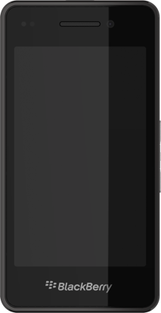
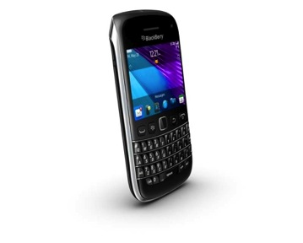
BBM Social Platform APIs
Use the BBM SP seamlessly between BlackBerry 10 and BlackBerry OS 5-7!
BBM Social Platform
IMPORTANT – Use the same SKU in App World!!!

Slide 48
For More Information…
Come to the Lab! JAM 349 - BBM Integration in the NDK (Wed @ 3:30pm)
http://developer.blackberry.com/bbm
http://www.scoreloop.com/download/
We want to hear from you!
Let us know about the cool things you’ve done!
nkalkounis@rim.com - @nickkalkounis
skangas@rim.com - @souplala
msohm@rim.com MSohm in the BlackBerry Developer Forums

Slide 49
THANK YOU
JAM 347
Nick Kalkounis – Product Manager
Sonja Ängeslevä – Product Manager
Mark Sohm – Developer Relations
February 5-6, 2013

